Slide 1

Internship Project
Presentation
E-Commerce Sales Dashboard using Tableau
NAME
COMPANY
DURATION
Disha Mourya
EduTech Solutions
[04-6-2026 – 08-08-2026]

Slide 2
Project Timeline
Presentation
Developed as part of the Data Analytics Internship at EduTech Solutions using Tableau and the Olist E-Commerce Dataset.
Week 1 → Dataset Collection & Data Understanding
Week 2 → Data Cleaning & Relationship Creation
Week 3 → Dashboard Development & KPI Creation
Week 4 → Dashboard Testing, Documentation & Submission

Slide 3
Contents
01
Introduction
Slide 04
02
Company Overview
Slide 05
03
Objectives
Slide 06
04
Project Overview
Slide 07
05
Methodology
Slide 08
06
Tools & Technologies
Slide 09
07
Output
Slide 10
08
Challenges & Learning
Slide 11
09
Conclusion & Future Scope
Slide 12

Slide 4

Introduction
2 / 10
Internship Overview
Project Purpose
Domain Relevance
Analyze e-commerce sales data.
Build an interactive Tableau dashboard..
Create business KPIs.
Visualize customer and sales trends.
Support business decision-making using data.
Business Intelligence dashboards help organizations monitor performance, identify trends, and make informed decisions through visual analytics..
They transform raw data into meaningful insights, enabling businesses to track key performance indicators (KPIs), understand customer behavior, optimize operations, and improve overall decision-making.
Domain: Data Analytics
Company: EduTech Solutions
Project: E-Commerce Sales Dashboard using Tableau
Focus Areas: Data Cleaning ,Data Visualization, Dashboard Development , KPI Analysis , Business Intelligence
Outcome: Successfully developed an interactive Tableau dashboard that provides meaningful insights into e-commerce sales, customer behavior, payment methods, and order status..

Slide 5

Company Overview
3 / 10
About EduTech Solutions
Key Services
Data Analytics Training
Business Intelligence Solutions
AI & Machine Learning Projects
Internship Programs
Career Development
EduTech Solutions is a technology-driven company focused on skill development and industry-based learning.
It provides practical internship programs that help students gain real-world experience through live projects.
The company offers training and project opportunities in Data Analytics, Artificial Intelligence, Web Development, Machine Learning, Business Intelligence, and other emerging technologies.
Internship Structure
Its objective is to bridge the gap between academic knowledge and industry requirements by providing hands-on learning and mentor guidance.
Week 1–2: Data Understanding & Cleaning
Week 3–4: Dashboard Development
Week 5–6: KPI Creation & Visualization
Week 7-8: Documentation & Final Submission
EduTech Solutions encourages students to build practical skills, develop professional portfolios, and prepare for successful careers in the IT industry.

Slide 6
Briefly describe the project objectives
01
02
03
Analyze Sales Performance:-
Monitor overall sales, revenue, and order trends to evaluate business performance through interactive dashboards.
Customer & Product Insights:-
Identify customer behavior, top-selling product categories, and preferred payment methods using data visualization.
Build an Interactive Dashboard:-
Develop a Tableau dashboard with KPIs, charts, and filters to support data-driven business decisions.

Slide 7
Project overview
The E-Commerce Sales Dashboard is a Business Intelligence project developed using Tableau with the Olist Brazilian E-Commerce Dataset. The project integrates multiple datasets, including orders, customers, products, order items, and payments, to provide a complete view of business performance. Interactive KPIs and visualizations were created to analyze sales trends, customer activity, product categories, payment methods, and order status. The dashboard helps businesses identify key insights, monitor performance, and make informed, data-driven decisions through clear and interactive visual analytics.

Slide 8



Objectives
4 / 10
Learning Goals
Technical Development
Project Objectives
Learn Tableau Dashboard Development.
Understand Business Intelligence concepts.
Gain practical knowledge of data visualization.
Work with multiple related datasets.
Build KPI cards.
Create interactive dashboards.
Establish table relationships.
Analyze business performance.
Analyze sales performance.
Monitor customer activity.
Identify top-performing products.
Understand payment trends.
Support business decision-making.

Slide 9

Methodology
6 / 10
01
Planning & Dataset Understanding
02
Data Preparation
03
Dashboard Development
04
Testing & Documentation
Missing Value Check
Duplicate Check
Relationship Creation
Data Validation
KPI Creation
Charts
Formatting
Interactive Dashboard
Dashboard Testing
README
Project Report
GitHub Upload
Project Planning
Requirement Analysis
Dataset Collection
Business Understanding

Slide 10

Project Overview
5 / 10
Problem Statement
Scope
E-commerce businesses generate a large volume of sales, customer, product, and payment data every day, making manual analysis difficult and time-consuming.
Without a centralized dashboard, it is challenging to monitor key business metrics such as total revenue, customer count, order status, and payment trends.
Business managers often struggle to identify top-performing product categories, monthly sales patterns, and customer purchasing behavior from raw data.
Multiple datasets stored in separate files make it difficult to combine and analyze information accurately without proper data relationships.
There is a need for an interactive Business Intelligence dashboard that can transform raw data into meaningful visual insights and support faster, data-driven business decisions.
This project addresses these challenges by developing an interactive Tableau dashboard that integrates multiple datasets and provides clear, real-time business insights through KPIs and visualizations.
Analyze sales performance.
Track customer orders.
Monitor payment methods.
Identify top-selling categories.
Visualize order status.
Approach
Planning
Data Collection
Data Cleaning
Relationship Creation
Dashboard Development
Testing
Documentation

Slide 11

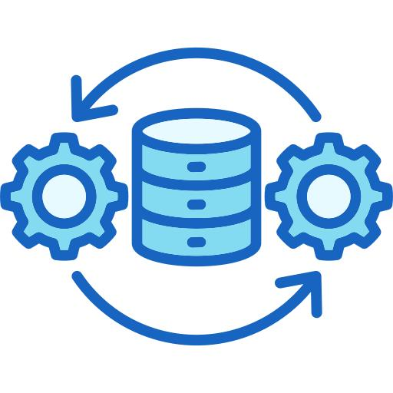
Tools & Technologies
7 / 10
Data Analysis & Visualization
Data Processing & Management
Business Intelligence & Reporting
Tableau Desktop
Data Cleaning
Business Intelligence (BI)
Microsoft Excel
Data Validation
Sales Trend Analysis
CSV Dataset
Relationship Modeling
Customer Insights
Data Visualization
KPI Creation
Dashboard Testing
Dashboard Development
Data Preparation
GitHub & Documentation

Slide 12

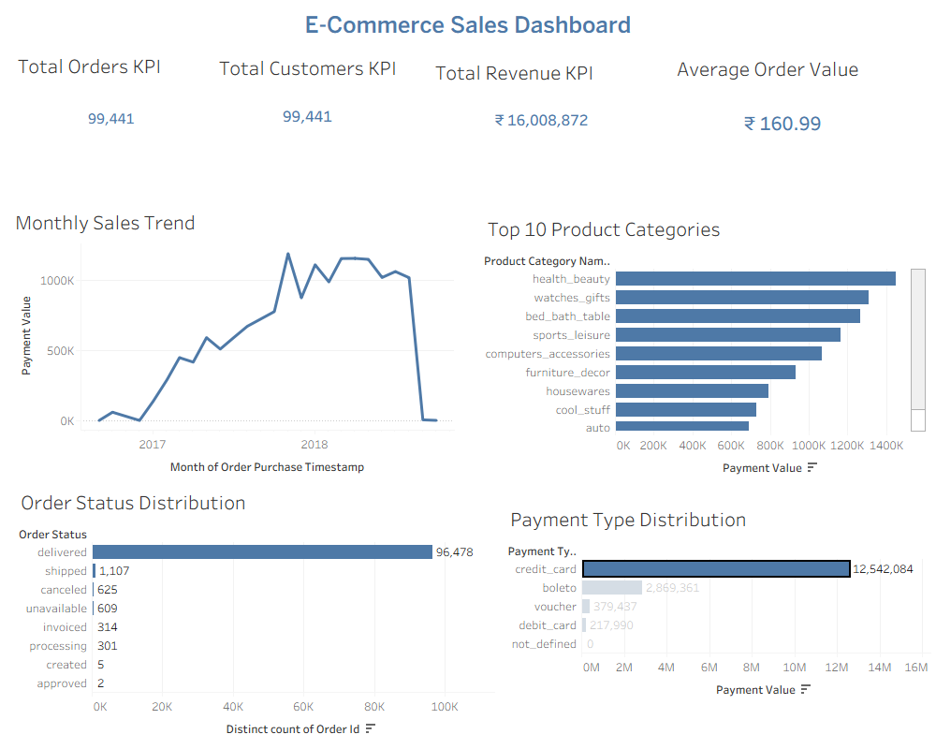
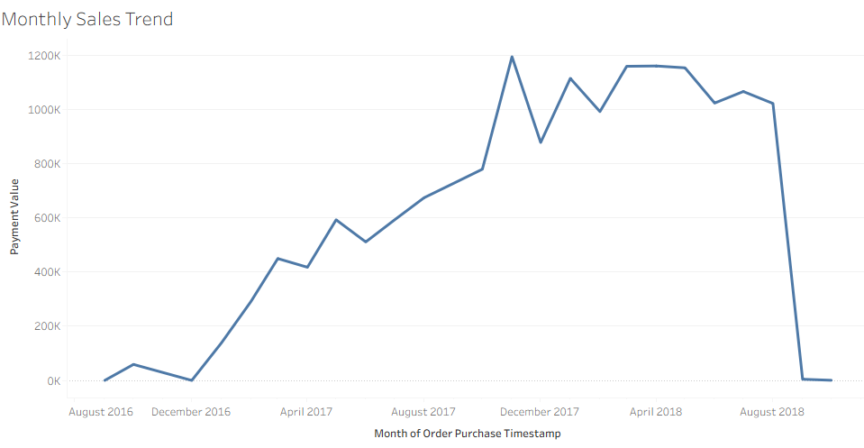
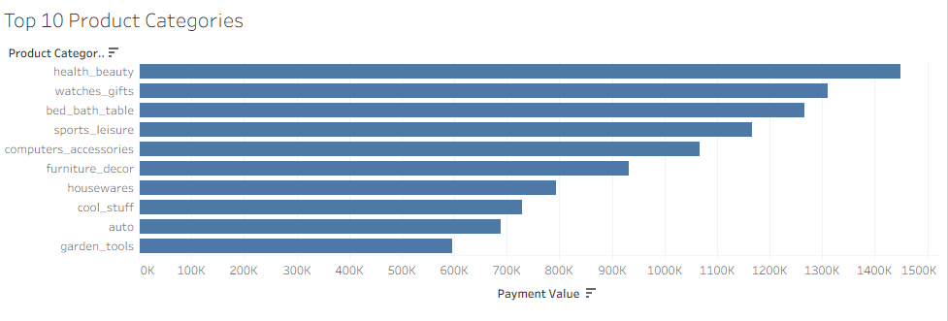
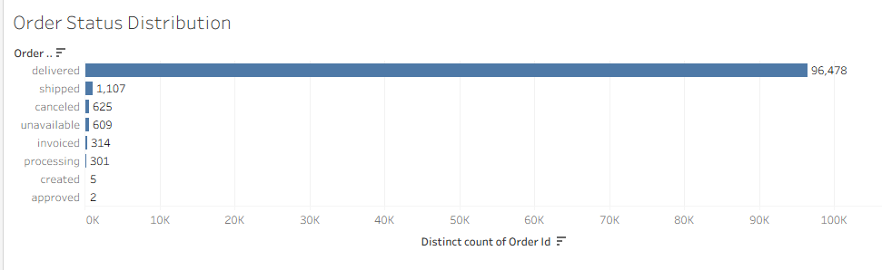
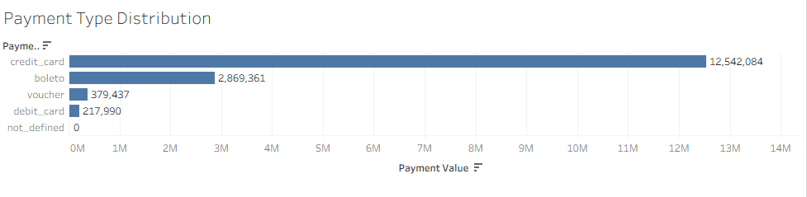
OUTPUT
8 / 10

Slide 13

Challenges & Learning
9 / 10
Challenges Faced & Solutions Applied
Skills Gained
⚠ Handling Multiple CSV Files
✓
Tableau Dashboard Development
→ Created proper relationships between datasets.
✓
Data Cleaning
⚠ Missing Values
✓
Data Visualization
→ Verified and handled blank records.
✓
KPI Design
⚠ Dashboard Layout
→ Improved formatting and alignment.
✓
Microsoft Excel
✓
Business Intelligence
⚠ Tableau Configuration
→ Resolved connection and visualization issues.
✓
GitHub

Slide 14


Conclusion & Future Scope
10 / 10
Project Summary
Achievements
Future Improvements
Successfully developed an interactive Tableau dashboard using the Olist Brazilian E-Commerce dataset.
Created business KPIs, charts, and visualizations to monitor sales performance and customer behavior.
Interactive Dashboard
Professional KPI Cards
Multiple Business Charts
Real-world Data Analysis
Region-wise Sales Analysis
Customer Segmentation
Profit Dashboard
Forecasting
Live Data Integration
Thank You | Questions & Feedback Welcome | Data Analytics Intern EduTech Solutions | [Disha Mourya]

